Slide 1
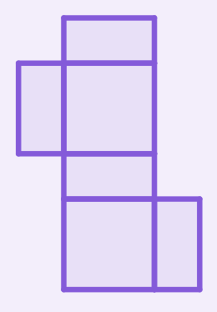
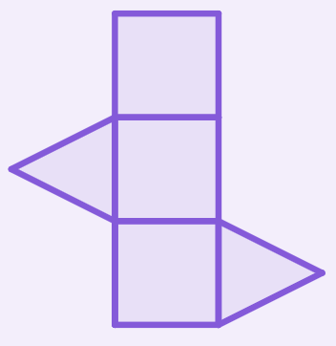
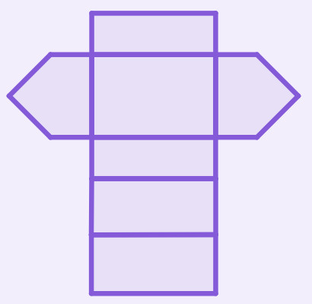
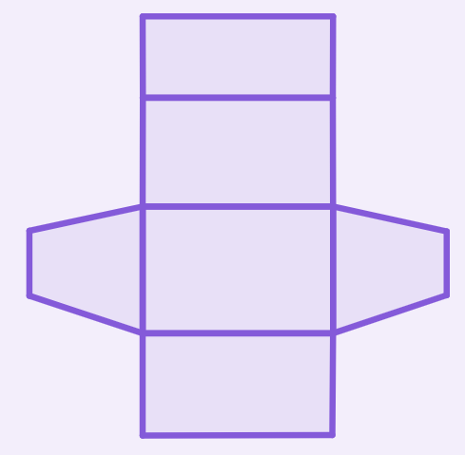
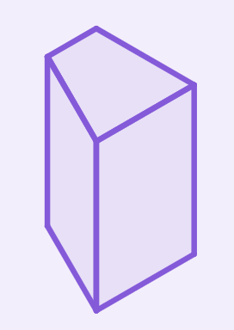


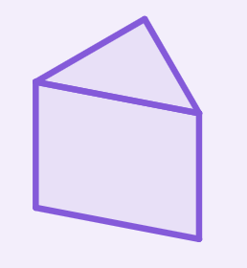

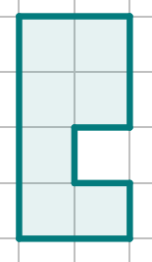

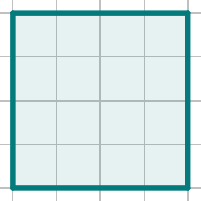
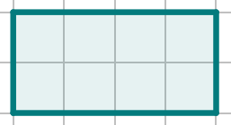
Surface area of prisms
Task A: Nets of right prisms
1) Match the net to its prism. Sketch the missing net and prism.
e.g.
e.g.
Task B: Calculating the surface area of prisms
1) a) Complete the description of the faces for this right octagonal prism.
irregular octagons 8
b) Draw all the unique faces of this prism, with dimensions.
2
rectangles
2
4 ✕
1
4
2 ✕
2
4
1 ✕
4
1
4
1
3 ✕
2
2
4

Slide 2
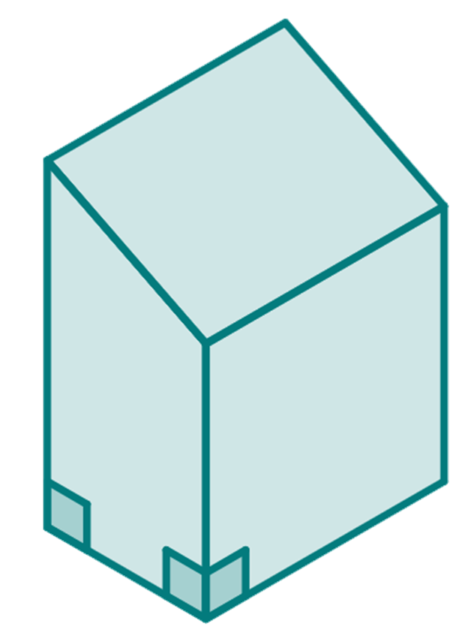

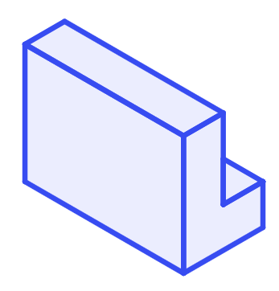

Surface area of prisms
2) Work out the surface area of this right trapezium based prism.
3 cm
2.6 cm
2 ✕ area of each trapezium
= 2 ✕ ( ✕ (4 + 3) ✕ 2) = 14 cm
rectangle 1 = 2 ✕ 3 = 6 cm²
rectangle 2 = 3 ✕ 3 = 9 cm²
rectangle 3 = 3 ✕ 2.6 = 7.8 cm²
rectangle 4 = 3 ✕ 4 = 12 cm²
Surface area
= 14 + 6 + 9 + 7.8 + 12 = 48.8 cm²
4 cm
3 cm
2 cm
Task C: Being efficient in finding the surface area
Diagrams not drawn to scale
Calculate the surface area of the following right prisms
1)
1 m
1 m
12 m
2 m
2 × Area of L shape
= 2 × ((3 × 2) - (2 × 1))
= 2 × 4 = 8 m²
3 m
3 m
1 m
1 m
1 m
2 m
2 m
Perimeter of L shape
12 × perimeter of L shape
= 12 × (3 + 1 + 2 + 1 + 1 + 2)
= 12 × 10 = 120 m²
12 m
Surface area = 128 m²
2)
6 mm
9 mm
3 mm
6 mm
2 × Area of L shape
= 2 × ((9 × 9) - (6 × 6))
= 2 × 45 = 90 mm²
12 mm
6 mm
9 mm
3 mm
3 mm
9 mm
9 mm
12 × perimeter of L shape
= 12 × (9 + 3 + 6 + 6 + 3 + 9)
= 12 × 36 = 432 mm²
Perimeter of L shape
12 mm
Surface area = 522 mm²
Mathematics in Education and Industry.
v2.2

Slide 3

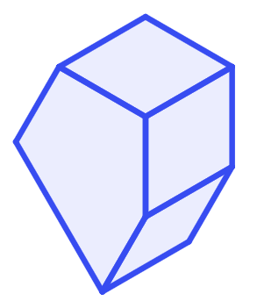
Surface area of prisms
3)
10 cm
12 cm
13 cm
2 × Area of triangle
= 2 × ( × 10 × 12)
= 120 cm²
4 cm
12 cm
13
cm
10 cm
Perimeter of triangle
4 × perimeter of triangle
= 4 × (13 + 10 + 13)
= 4 × 36 = 144 cm²
4 cm
Surface area = 264 cm²
4)
2 m
2 × Area of pentagon
= 2 × 45
= 90 m²
2 m
2 m
45 m²
4 m
2.5 m
2 m
Perimeter of pentagon
2 × perimeter of pentagon
= 2 × (2 + 4 + 2.5 + 2 + 2)
= 2 × 12.5 = 25 m²
2 m
Surface area = 115 m²
Mathematics in Education and Industry.

